Slide 1
Triathlon Performance
Eric, Estuar, Ryan

Slide 2
Challenges Faced (Part 1)
Scheduling
The group had to find free days in the week to focus most of their time on the project.
Most members of the group align their schedules to go on the course provided by the university to test out the robot.
Virtual and in person
Most of the time, the group had to communicate virtually to discuss how the project should be made and update other members in their goals.
The only times most of the group met in person was during the courses the robot had to run.

Slide 3
Challenges Faced (Part 2)
Different Perspectives
In the beginning of the project, the group had different ideas on how the project should be approached.
For example, the group did not decide whether to do the course first, with the code and algorithm being built, or to start writing the system design document before doing anything in person.
Fixing
The group had to fix the code for the robot to follow the courses without making any mistakes.
Usually, it took around 2-3 hours to help make the code work properly and for the robot to approach each course differently.

Slide 4
Roles of Each Member
Ryan
Ryan’s role was being the project manager by looking over different aspects of the project whether it be in person on the course.
He also was one of the people who coded the robot on the courses provided by the university.
Eric
Eric’s role was being the tester in the group by taking care of the robot everyday and to test out how the robot functioned in and out of the course.
He was also the other person responsible to make the code in person on the course.

Slide 5
Roles of Each Member (Part 2)
Estuar
Estuar’s role in the project was to create:
the system design document
the algorithm
the flowchart
Gantt Chart
He looked at the measurement videos provided by the class and a list the group provided to make the algorithm and flowchart.

Slide 6
What Did We Learn About Software Engineering?
Extend time
What we learned about software engineering is that it is very time consuming
A lot of time is needed to see if the robot did what is supposed to do across the three sprints.
Teamwork and communication
This is important to know the group was on the same page and to not put everything on one person.
The project was bigger for one person so one person did certain tasks and updated the group.
Coding
Code that someone makes in the beginning of the project would change in some way for the robot to improve in the course.

Slide 7
What Would We do Differently?
More time
Some of the things that we would have done differently is to allow ourselves more time to be able to test the robot more.
The robot did all the sprints as intended, but the group had to do it in one or two days being on the course for hours.
Downscaling
The group would also downscale the measurements the course had instead of only relying on the course for test cases.
For example, one or two group members could have met and downscaled the code for the robot to do the tasks that were intended.

Slide 8
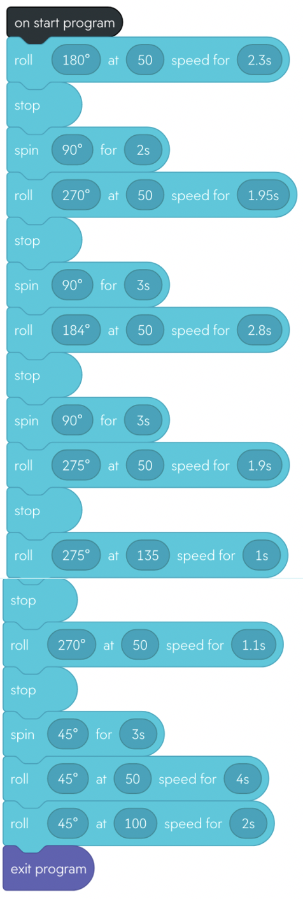
Block Code for Sprint 3-Agility
The robot had to follow this description during Sprint 3- Agility to complete the course:
When the robot starts, go straight for 3 feet and 3 inches at 180 degrees
Next, the robot should turn 90 degrees
Run straight for 3 feet and 3 inches at 270 degrees
The robot should turn 90 degrees afterwards
Go straight for 3 feet 10 inches and at 184 degrees.
The robot would turn 90 degrees and go straight for 7 feet 2 inches at 275 degrees and Turn 270 degrees for the robot to adjust back to the path
The robot would turn 45 degrees.
The next step would be the robot would go straight for 9 feet and 1 inch at 45 degrees resulting in the pins falling.

Slide 9

Video of Sprint 3- Agility

